Slide 1
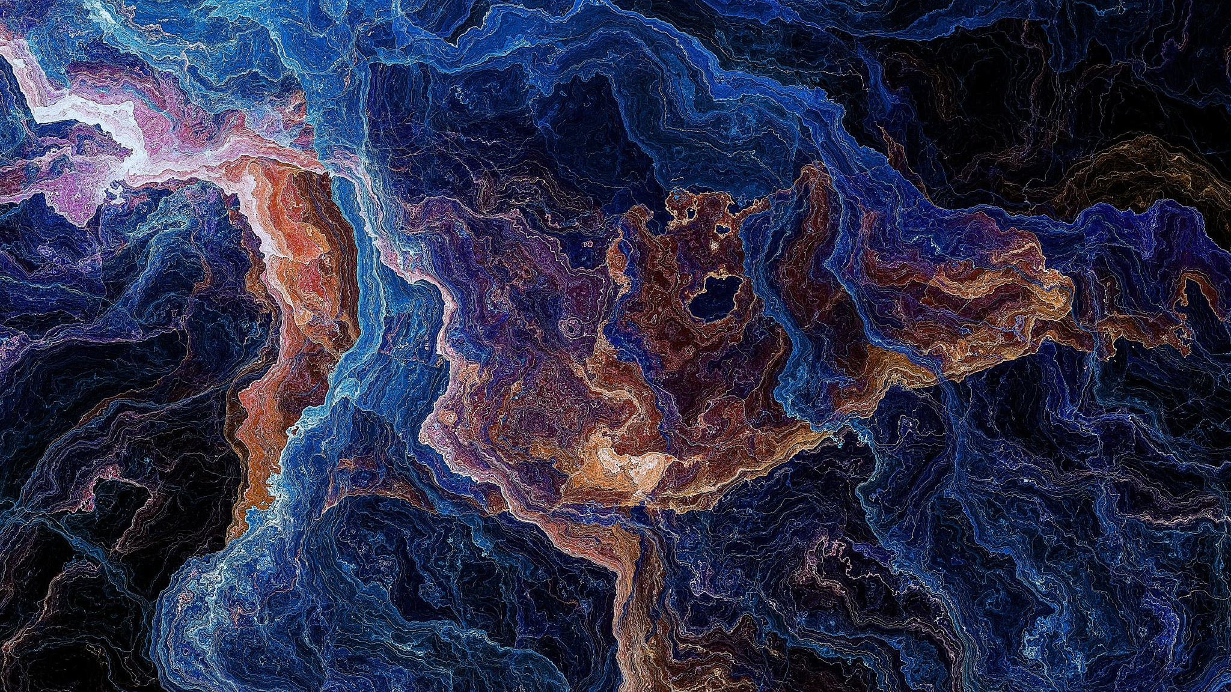
IMAGE CAPTION GENERATOR
Prudhvi Tadikonda(1001774416)
Satish Rella(1001677995)
Aditya Sagam(1001660179)

Slide 2
Develop Deep Learning Model
We will define the deep learning model and fit it on the training dataset.
It divided into the four steps:
Loading data
Defining the Model
Fitting the Model
Complete Example

Slide 3
Loading the Data
We are going to train the data on all the photos and captions in the training dataset.
The train and development dataset have been predefined in the Flickr_8k.trainImages.txt and Flickr_8k.devImages.txt files respectively, that both contain lists of photo file names. From these file names, we can extract the photo identifiers and use these identifiers to filter photos and descriptions for each set.
The model we will develop will generate a caption given a photo, and the caption will be generated one word at a time. The sequence of previously generated words will be provided as input. Therefore, we will need a ‘first word’ to kick-off the generation process and a ‘last word‘ to signal the end of the caption.
Running this example first loads the 6,000 photo identifiers in the test dataset. These features are then used to filter and load the cleaned description text and the pre-computed photo features

Slide 4
Continuation..
The create_sequences() function explains, given the tokenizer, a maximum sequence length, and the dictionary of all descriptions and photos, will transform the data into input-output pairs of data for training the model. There are two input arrays to the model: one for photo features and one for the encoded text. There is one output for the model which is the encoded next word in the text sequence.
We loaded the data for the training and development datasets and transform the loaded data into input-output pairs for fitting a deep learning model.

Slide 5
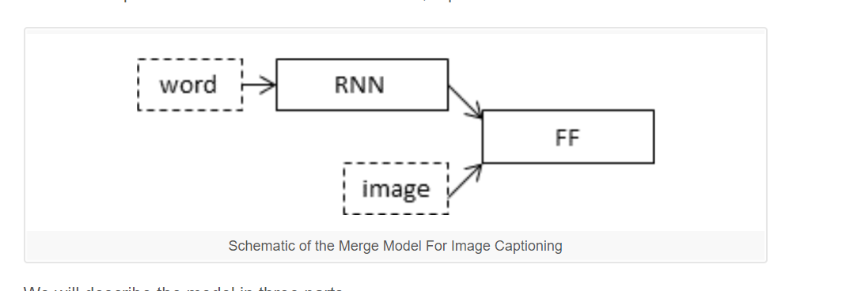
Defining the Model

Slide 6
We will describe the model in three parts:
Photo Feature Extractor. This is a 16-layer VGG model pre-trained on the ImageNet dataset. We have pre-processed the photos with the VGG model (without the output layer) and will use the extracted features predicted by this model as input.
Sequence Processor. This is a word embedding layer for handling the text input, followed by a Long Short-Term Memory (LSTM) recurrent neural network layer.
Decoder (for lack of a better name). Both the feature extractor and sequence processor output a fixed-length vector. These are merged together and processed by a Dense layer to make a final prediction.

Slide 7
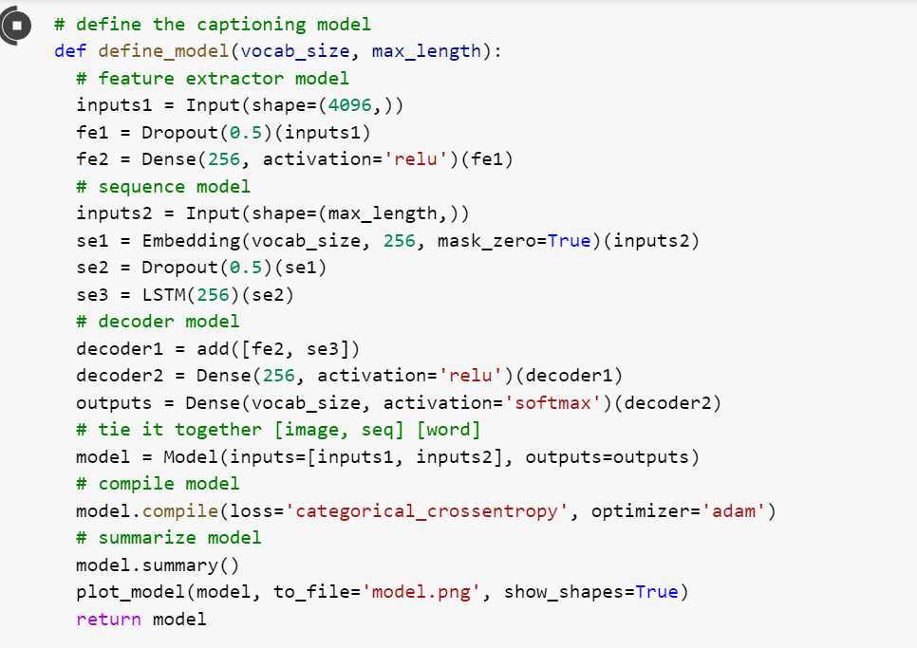
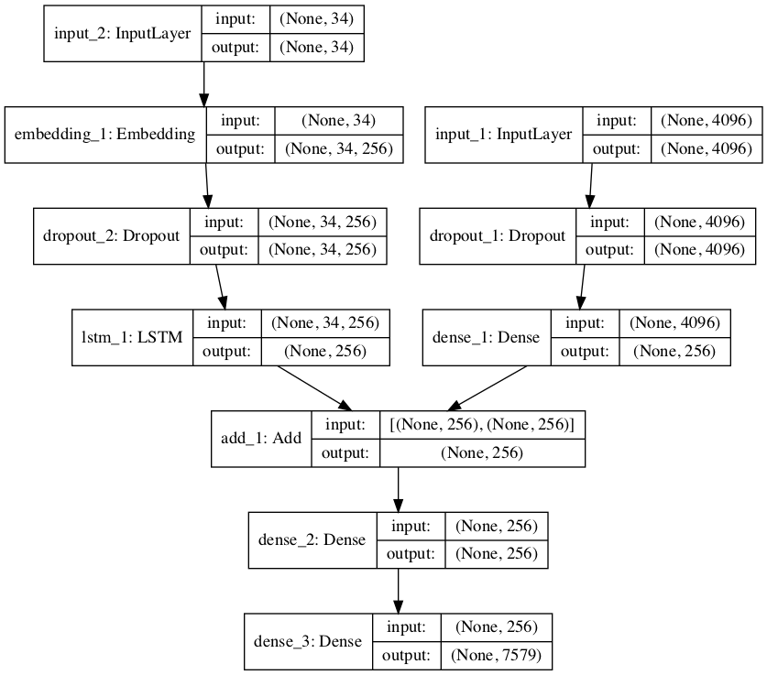

Slide 8
Fitting the Model
Now we can fit the model with training dataset.
The model learns fast and quickly overfits the training dataset. For this reason, we will monitor the skill of the trained model on the holdout development dataset. When the skill of the model on the development dataset improves at the end of an epoch, we will save the whole model to file.
We can do this by defining a ModelCheckpoint in Keras and specifying it to monitor the minimum loss on the validation dataset and save the model to a file that has both the training and validation loss in the filename.
We will only fit the model for 20 epochs, but given the amount of training data, each epoch may take 30 minutes on modern hardware.
The model then runs, saving the best model to .h5 files along the way.

Slide 9
Train With Progressive Loading
We used progressive loading which takes 8GB of RAM.
Some off-the-cuff ideas for further improving this data generator include:
Randomize the order of photos each epoch.
Work with a list of photo ids and load text and photo data as needed to cut even further back on memory.
Yield more than one photo’s worth of samples per batch.

Slide 10
Evaluate the Model
We will evaluate a model by generating descriptions for all photos in the test dataset and evaluating those predictions with a standard cost function.
The function generate_desc() implements this behavior and generates a textual description given a trained model, and a given prepared photo as input. It calls the function word_for_id() in order to map an integer prediction back to a word.
We will generate predictions for all photos in the test dataset and in the train dataset.
The function evaluate_model() will evaluate a trained model against a given dataset of photo descriptions and photo features. The actual and predicted descriptions are collected and evaluated collectively using the corpus BLEU score that summarizes how close the generated text is to the expected text.
BLEU scores are used in text translation for evaluating translated text against one or more reference translations.

Slide 11
Generate New Captions.
We can hard code the maximum sequence length. With the encoding of text, we can create the tokenizer and save it to a file so that we can load it quickly whenever we need it without needing the entire Flickr8K dataset. An alternative would be to use our own vocabulary file and mapping to integers function during training.
We can create the Tokenizer as before and save it as a pickle file tokenizer.pkl.
We will generate a description for it using our model.
We could do this by re-defining the model and adding the VGG-16 model to it, or we can use the VGG model to predict the features and use them as inputs to our existing model. We will do the latter and use a modified version of the extract_features() function used during data preparation but adapted to work on a single photo.
Output:
1 | startseq dog is running across the beach endseq

Slide 12
Planning to Implement different from Reference
In reference they have used the VGG16 Model for interpreting the content in the image.
We are trying to implement the RSNET50 Model for interpreting the model .

Slide 13
Thank You
Any questions..?

